Slide 1


Project Report

Slide 2

Project Report VTC Store website
Semmester: SEM 2
Class: WD02
Group: G03
Instructor: Vũ Trần Lâm
Members: NDE18011 - Ngô Đức Nam
NDE18074 - Nguyễn Trung Thăng
NDE18091 - Lý Bảo Thắng
NDE18082 - Nguyễn Quốc Quảng
NDE18037 - Ngô Anh Tuấn

Slide 3
Objectives
 
I. Project introduction.
II. Analyze system requirements.
- Usecase
- Activity
III. Detailed design.
- ERD
- Database

Slide 4
Project introduction
 
1. Proposal system
VTC Store was created to provide apparel for men and perform one or more of the following functions: Register, View products and Buy products, etc.
2. Purpose and objective of the project
Purpose: Building an online website
- Meet the standards of a website:
Scientific structure, tight, clear, easy to navigate, exploit and edit
User friendly
Stable operation, security
Meet the functions required by customers
3. Scope of application
- The device has a network connection and uses a browser
4. System name
- VTC store

Slide 5
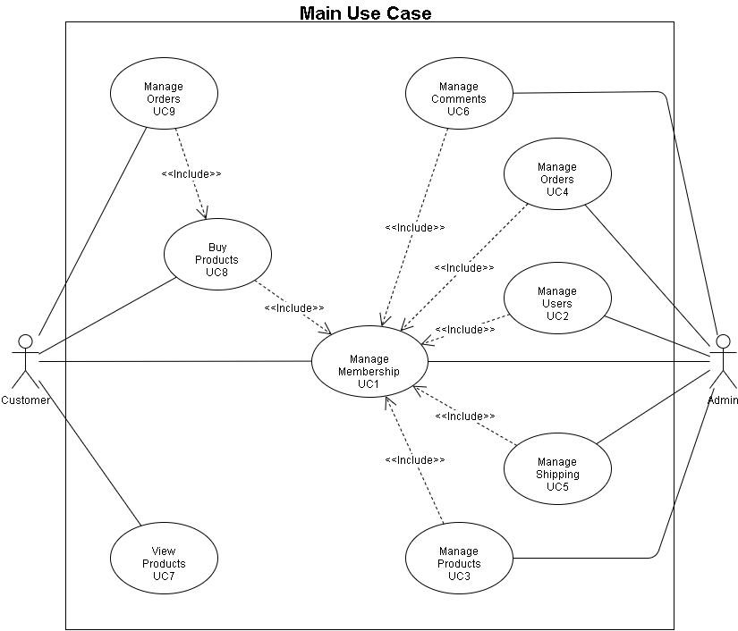
Analyze system requirements
1. Usecase

Slide 6
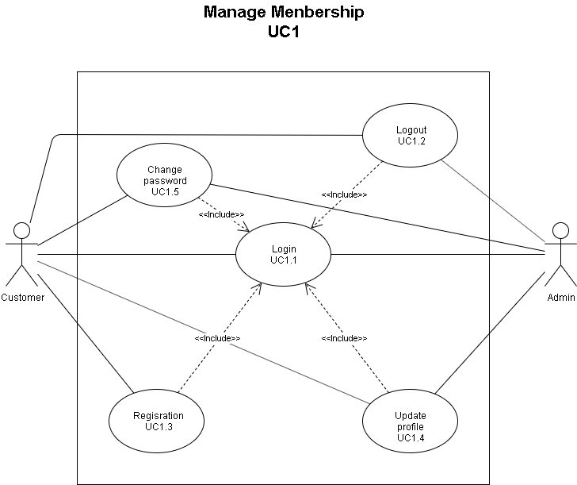
Analyze system requirements

Slide 7
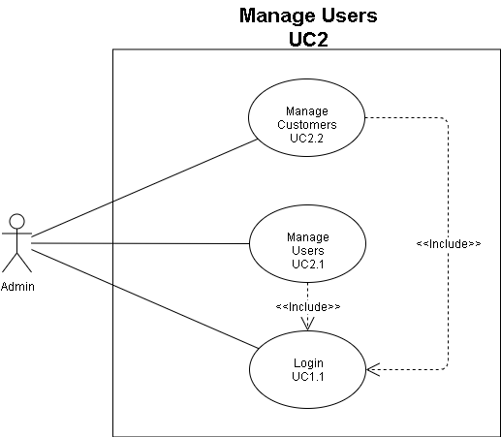
Analyze system requirements

Slide 8
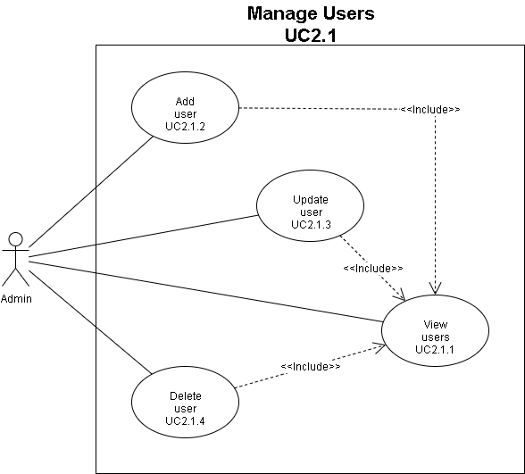
Analyze system requirements

Slide 9
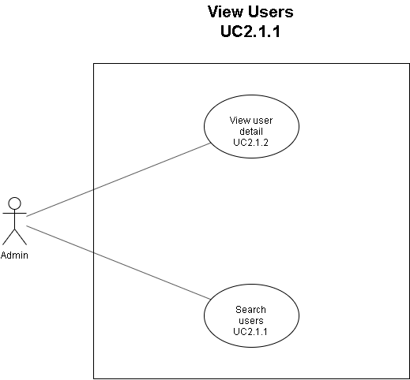
Analyze system requirements

Slide 10
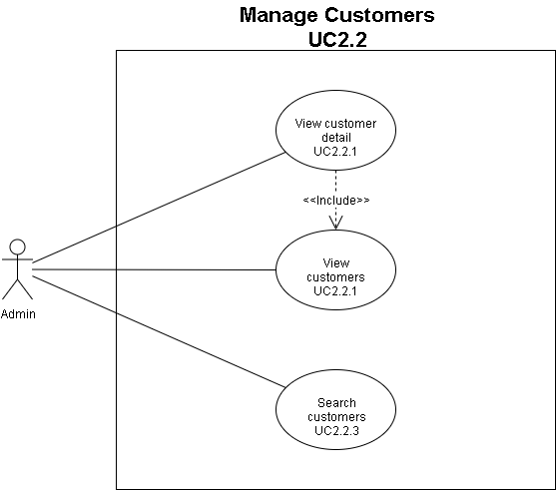
Use Case

Slide 11
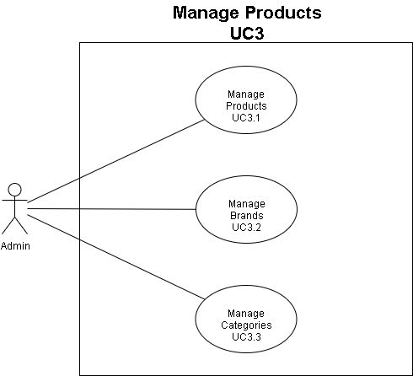
Analyze system requirements

Slide 12
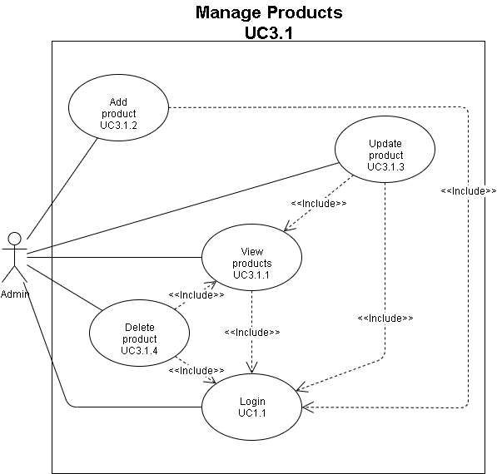
Analyze system requirements

Slide 13
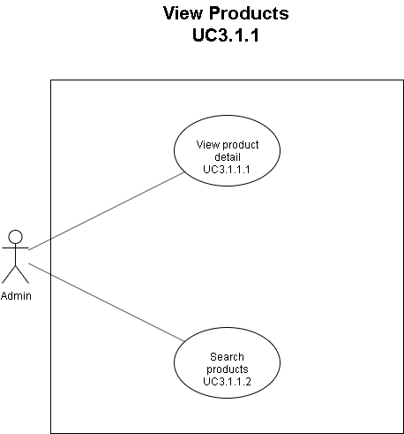
Analyze system requirements

Slide 14
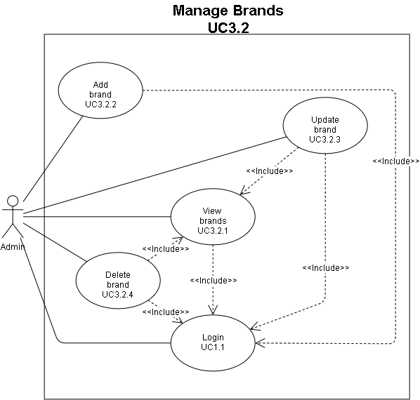
Analyze system requirements

Slide 15
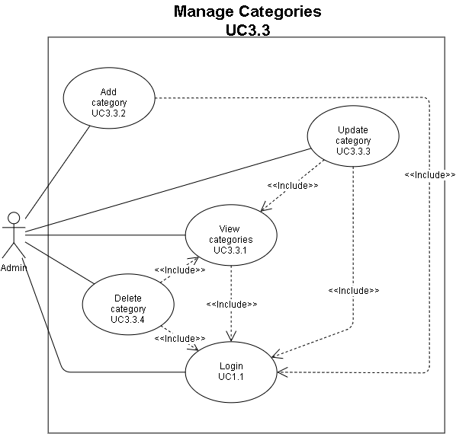
Analyze system requirements

Slide 16
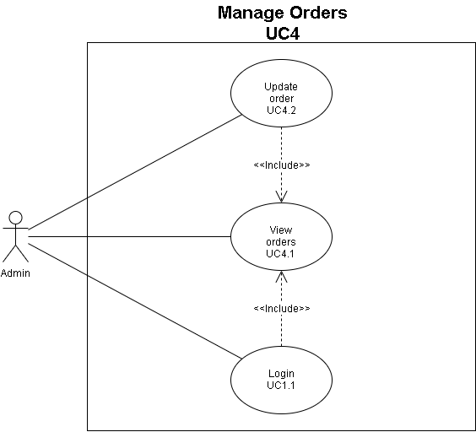
Analyze system requirements

Slide 17
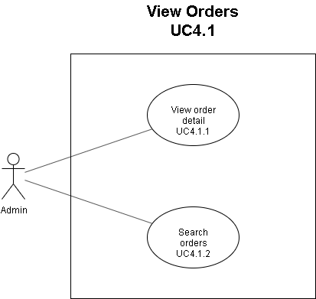
Analyze system requirements

Slide 18
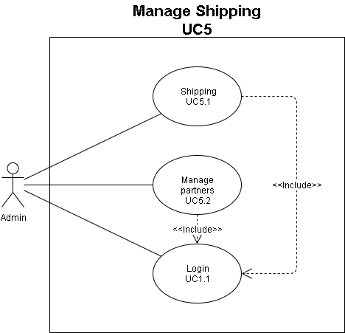
Analyze system requirements

Slide 19
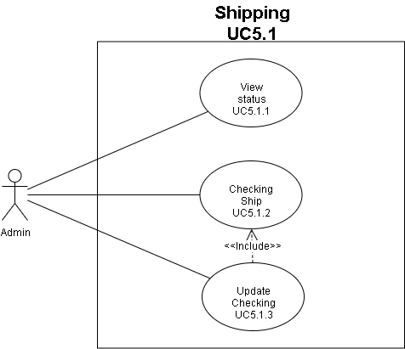
Analyze system requirements

Slide 20
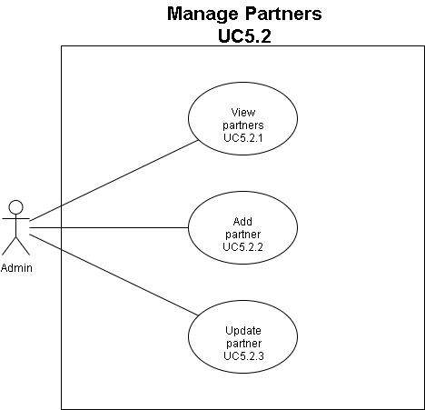
Analyze system requirements

Slide 21
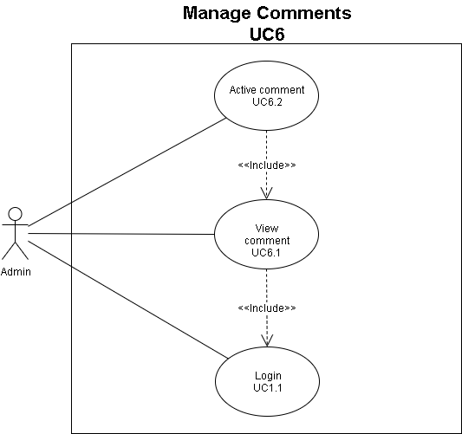
Analyze system requirements

Slide 22
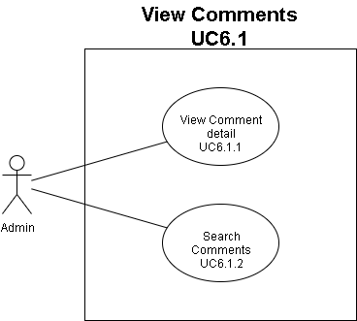
Analyze system requirements

Slide 23
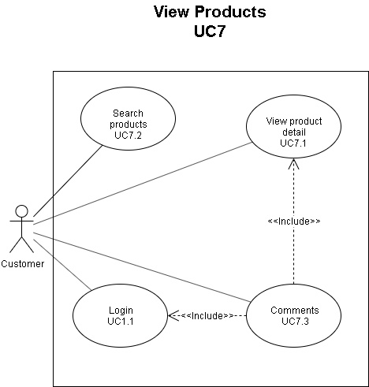
Analyze system requirements

Slide 24
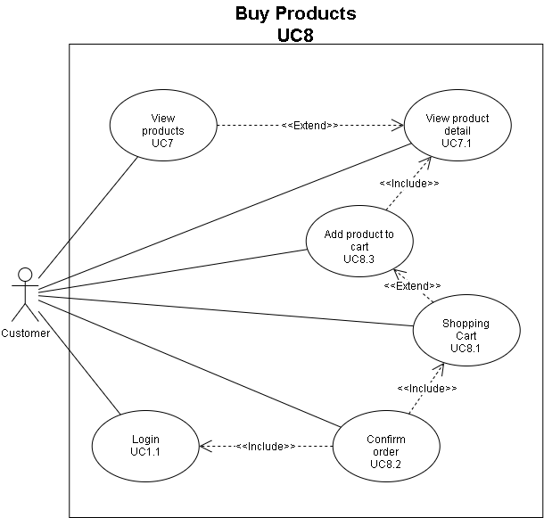
Analyze system requirements

Slide 25
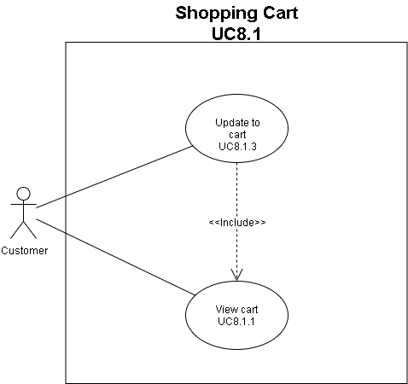
Analyze system requirements

Slide 26
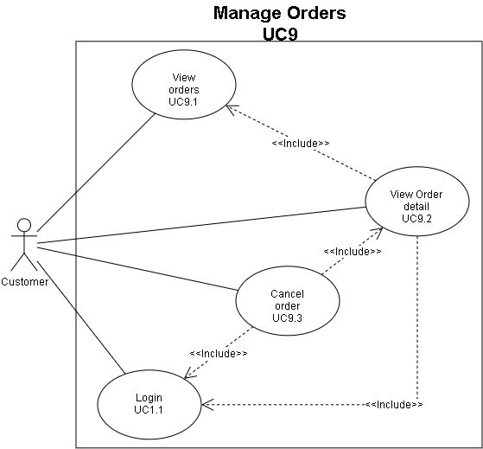
Analyze system requirements

Slide 27
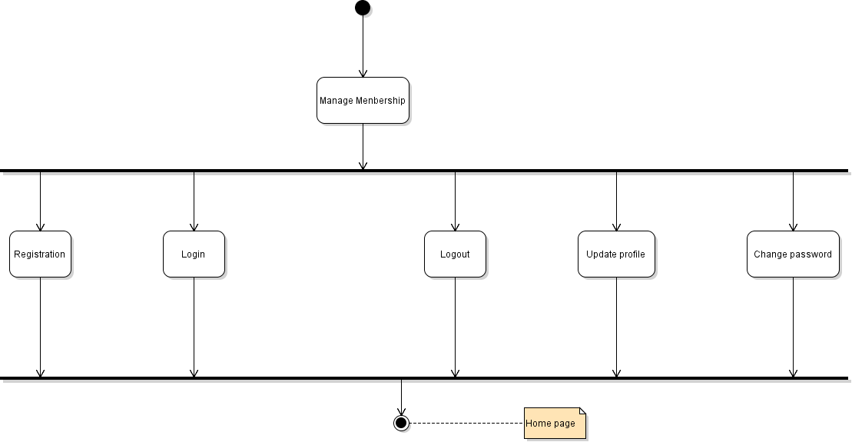
Activity Diagram
Manage Membership

Slide 28
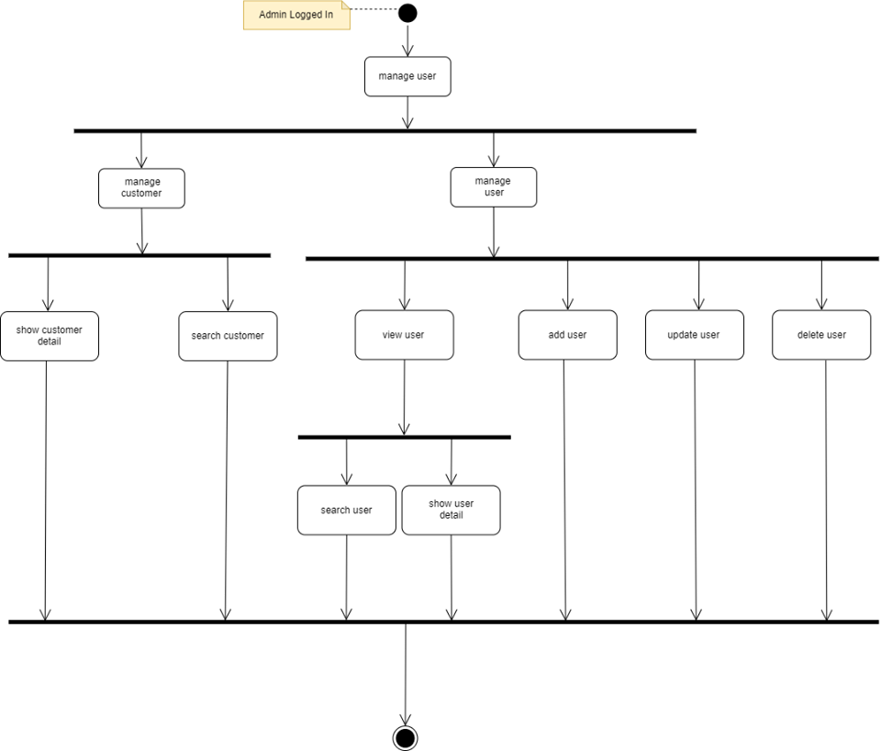
Activity Diagram
Manage User

Slide 29
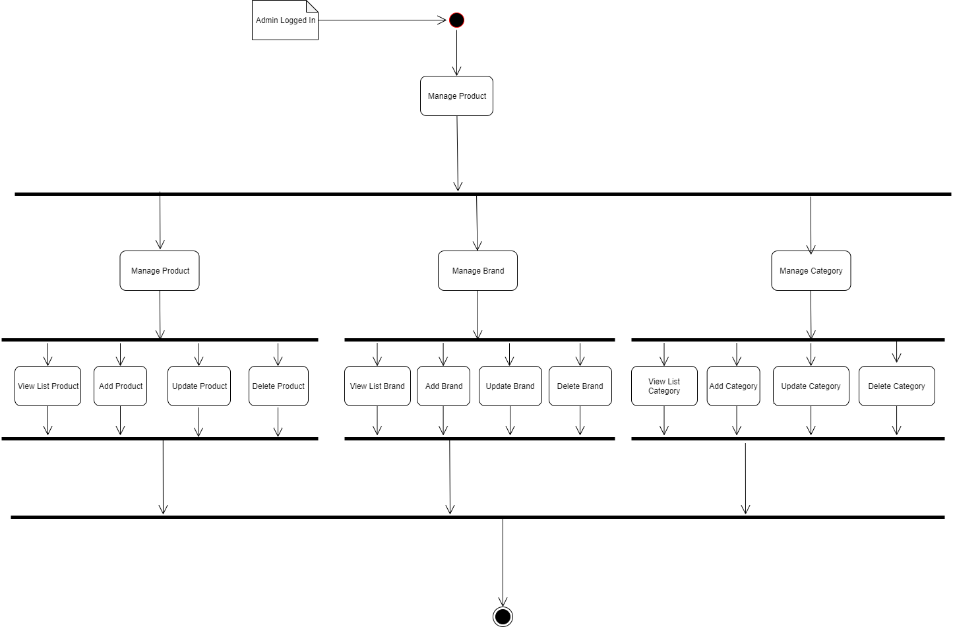
Activity Diagram
Manage Product

Slide 30
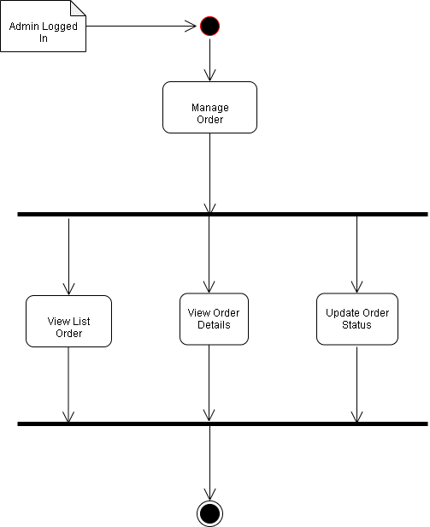
Activity Diagram
Manage Order

Slide 31
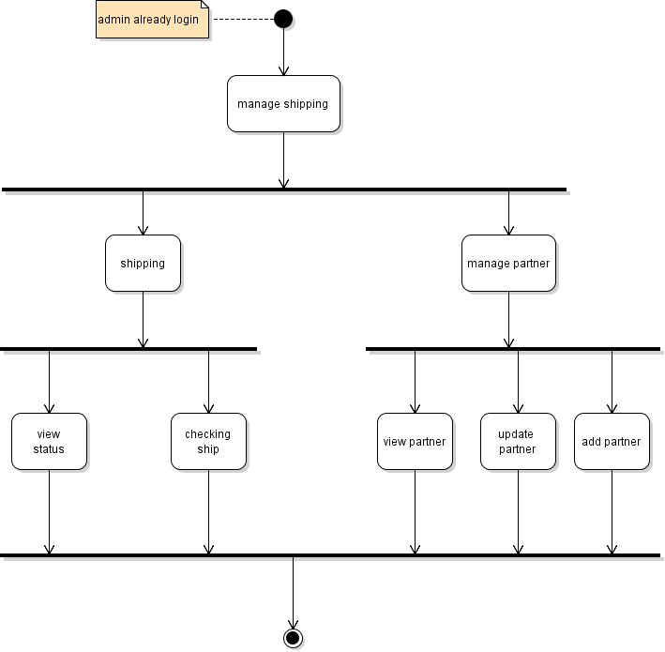
Activity Diagram
Manage Shipping

Slide 32
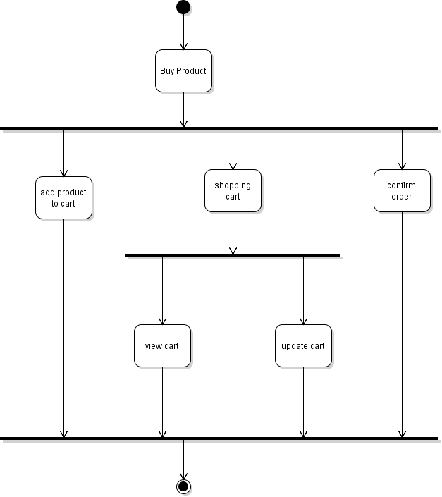
Activity Diagram
Buy Product

Slide 33
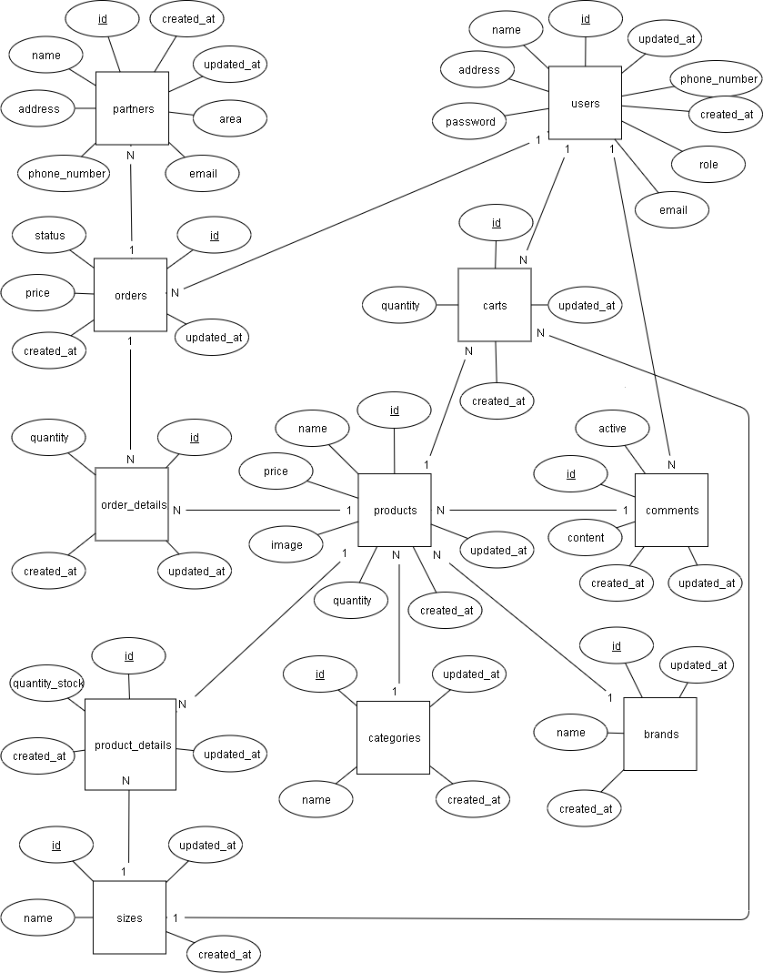
Entity Relationship Diagram

Slide 34
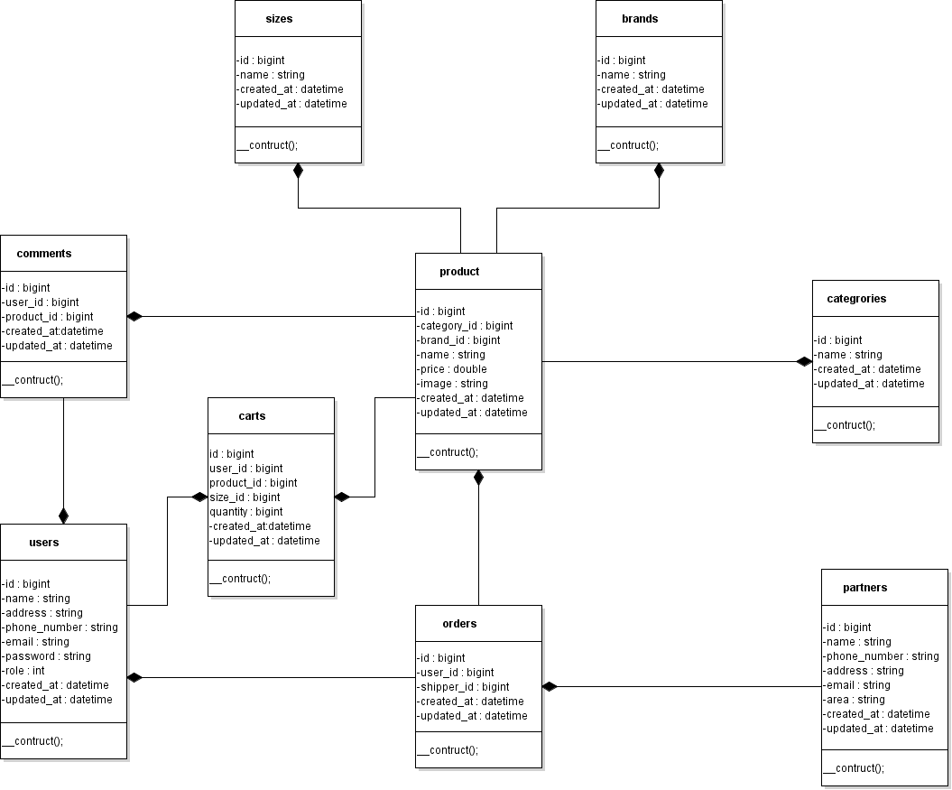
Class Diagram

Slide 35
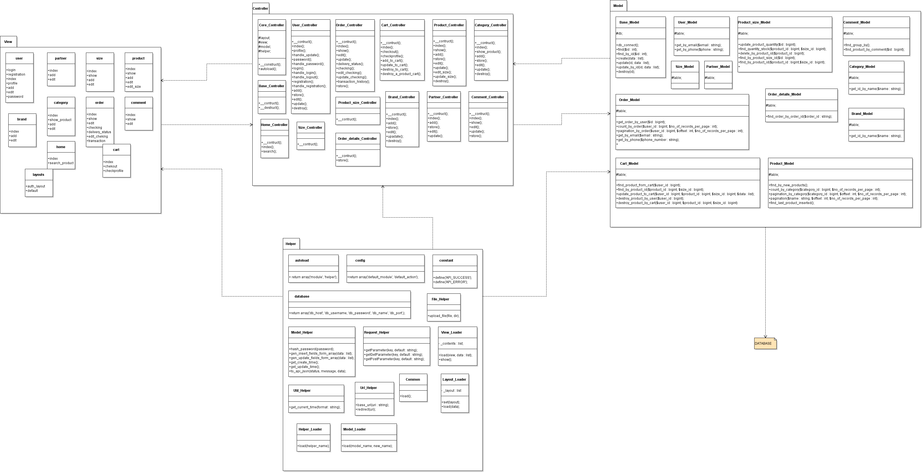
MVC Model

Slide 36
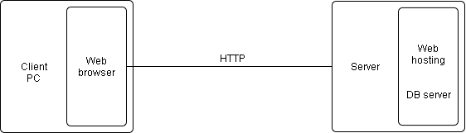
Installation Instruction
1.Deployment Diagram

Slide 37
Installation Instruction
Another problem
Results
Learn the working process
Relational database design
Draw Activity Diagram diagram, Sequence Diagram, Class diagram
Analyze and solve problems logically
Limit
Not solved the whole problem
Also limited in knowledge
Teamwork is not good

Slide 38
Q & A

